Slide 1


BF
Serge Adjognon, Daan van Soest

Slide 2
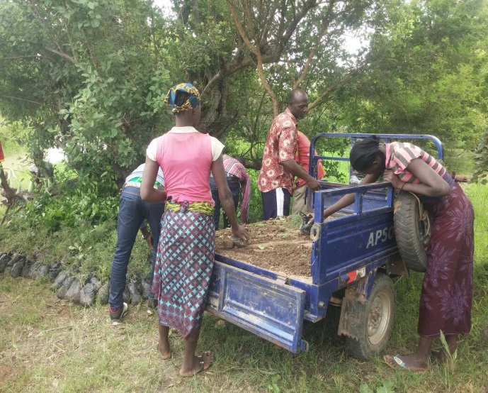
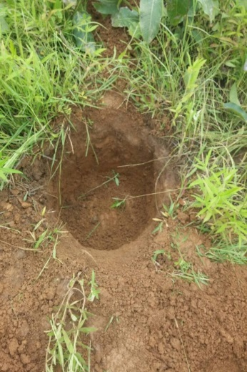
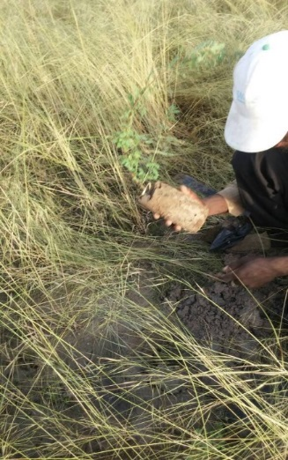
Activités août 2017-present: Evaluation d’impact des PSE pour l’entretien des jeunes plants Onze forêts divisés en 33 blocs au total Zones de protection de 35 hectares Reforestation sur trois parcelles de 5 hectares

Slide 3
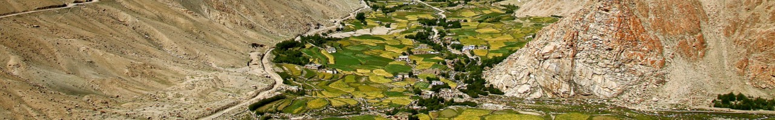








33,547 plants ont été comptés au total pour la campagne de reforestation de 2017

Slide 4




1ere Question d’évaluation d’impact
Y a t-il une façon particulier de mettre en œuvre les PSE pour les rendre plus efficaces pour la maintenance des plants ?
Tester les paiements basés sur un seuil de survie en comparaison avec les paiements linéaires

Slide 5
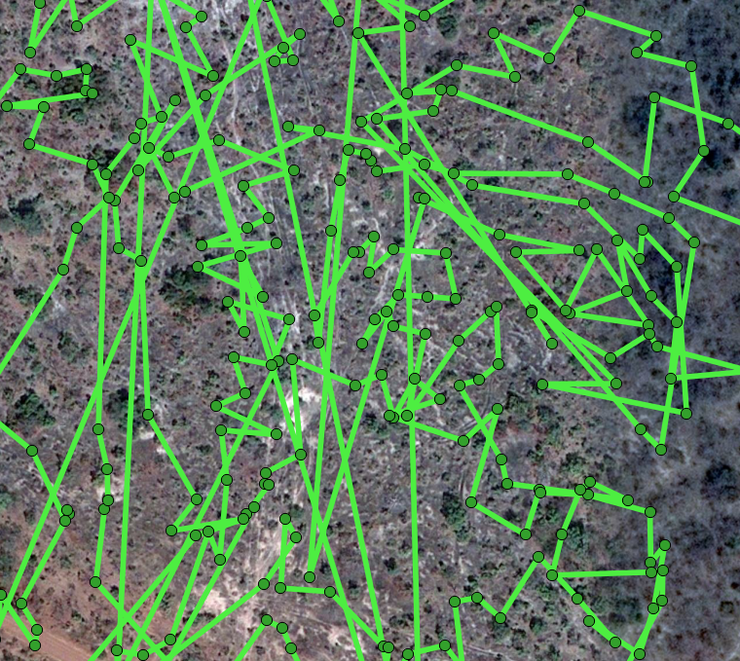
XXXX
Checking survival rates:
Undoable to find back the trees in the order they were planted last year
Alternative approach?
Obtenir la précision optimale
S’il y a plus de bandes dans une parcelle, la plus fiable est le échantillon

Slide 6
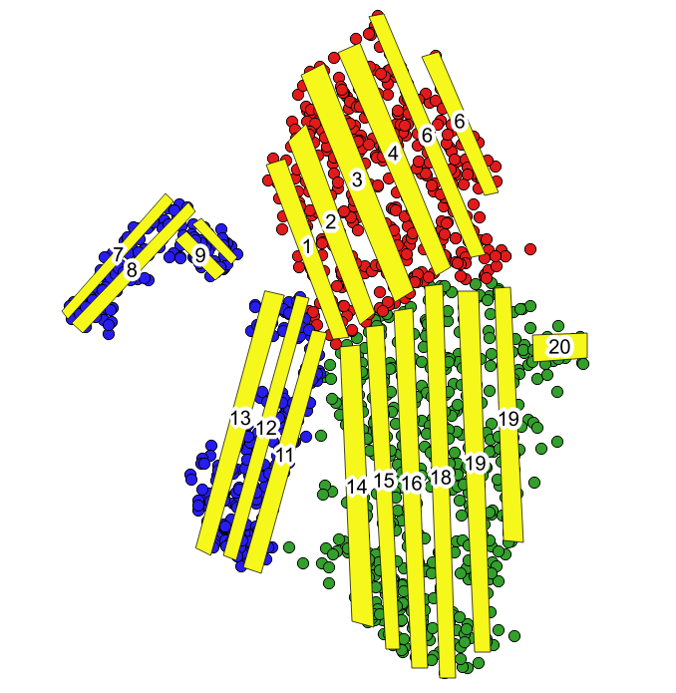
XXXX
Checking survival rates:
Undoable to find back the trees in the order they were planted last year
Alternative approach
Predetermined “corridors” covering substantial share of the land area
Count number of trees still alive…
And compare to number of trees that were planted before
Kf;ds
Obtenir la précision optimale
S’il y a plus de bandes dans une parcelle, la plus fiable est le échantillon

Slide 7
XXXX
Checking survival rates:
Undoable to find back the trees in the order they were planted last year
Alternative approach
Predetermined “corridors” covering substantial share of the land area
Count number of trees still alive…
And compare to number of trees that were planted before
Kf;ds
Obtenir la précision optimale
S’il y a plus de bandes dans une parcelle, la plus fiable est le échantillon

Slide 8
xxx
Balance test

Slide 9
Significantly higher survival rates in linear than in threshold
In terms of trees alive, but aeven more so in terms of trees with agood chance of survival

Slide 10
Can we explain survival rates?
(log of) average primary income, share of participants who are GGF member, and the (log of the) average value of livestock (= assets) all play a role
Income vs assets – available time vs wealth?

Slide 11
Mechanism: bunching just above threshold?
Compare distribution of numbers of trees alive across the treatments
Distribution under threshold just skewed more to the left; not evidence of

Slide 12
2. Honesty
Overreporting?
Quite substantial in both treatments
Significantly different for threshold, but not for linear

Slide 13
2. Honesty
Bunching near threshold?
Some evidence for this; compare just below 200 to just above, and just below 400 and just above (but not significantly so)
And also not very different from linear

Slide 14
2. Honesty
Farmers neither savvy nor (too) bold in overreporting
13 of 31 farmer groups in threshold did not overreport
Of the 18 that did overreport, 10 benefitted from that – but crossed just one threshold (not more)
Mean amount of “strategic” overreporting is 94 trees (ranging from 36 to 170 trees), but none of these differences resulted in crossing more than one threshold

